Slide 1
Unit-VI
Data Science

Slide 2
Definition
Data Science is a multidisciplinary field that combines statistics, mathematics, programming, and domain knowledge to extract insights and knowledge from structured and unstructured data.
It involves techniques from data analysis, machine learning, data mining, and visualization to analyze large amounts of data, discover patterns, and make informed decisions.
Data science is the study of data to extract knowledge and insights that can help businesses make decisions.

Slide 3
Key aspects of data science include:
Data Collection: Gathering raw data from various sources, such as databases, web scraping, sensors, or manual input.
Data Cleaning: Preparing data by removing errors, duplicates, and inconsistencies to ensure data quality.
Data Analysis: Using statistical and mathematical methods to explore data, identify patterns, and generate insights.
Machine Learning: Applying algorithms that allow computers to learn from data and make predictions or decisions.
Data Visualization: Representing data in visual formats like charts and graphs to make insights easier to understand and communicate.
Interpretation and Decision-Making: Translating data insights into actionable steps that drive business strategy, innovation, and problem-solving.
Data science is used in various fields, such as healthcare, finance, marketing, and engineering, to make data-driven decisions, improve processes, and drive innovation.

Slide 4
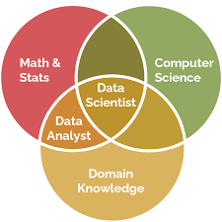

Slide 5
Importance of data Science
The importance of data science lies in its ability to transform raw data into actionable insights that drive better decision-making, improve efficiency, and foster innovation across numerous fields. Here are some key reasons why data science is crucial today.
In essence, data science is vital in today’s data-driven world because it empowers organizations, researchers, and governments to harness data for growth, innovation, and societal benefit

Slide 6
Informed Decision-Making
Data science enables organizations to make evidence-based decisions, reducing reliance on intuition and guesswork. By analyzing past and current data, businesses can identify trends, predict outcomes, and make strategic choices that improve their success rates.
Efficiency and Automation
Through data science, repetitive tasks can be automated, allowing organizations to streamline operations and reduce costs. Machine learning algorithms, for instance, can automate data processing, forecasting, and anomaly detection.
Improved Customer Insights and Personalization
Data science helps businesses understand customer behavior, preferences, and needs. This information is used to offer personalized experiences, develop targeted marketing campaigns, and improve customer satisfaction, leading to higher retention rates and loyalty.

Slide 7
Risk Management
By identifying patterns and anomalies, data science helps detect potential risks, such as fraud or operational inefficiencies, early. Financial institutions, for example, use data science to detect fraudulent transactions and assess credit risk.
Enhanced Product Development
Data science enables organizations to analyze customer feedback, market trends, and user behavior, providing insights that guide product improvements or new product development. This ensures products are more aligned with market demands and customer needs.
Healthcare Advancements
In healthcare, data science is used to predict disease outbreaks, improve diagnostic accuracy, personalize treatments, and optimize hospital operations. This leads to better patient outcomes and more efficient healthcare systems.

Slide 8
Scientific Research and Discovery
In fields like biology, physics, and climate science, data science is crucial for processing and analyzing massive datasets that would be impossible to interpret manually. This accelerates discoveries and the development of new technologies.
Better Supply Chain Management
Data science helps companies optimize their supply chain by predicting demand, identifying bottlenecks, and improving inventory management. This leads to cost savings and more resilient operations.

Slide 9
Competitive Advantage
Organizations that harness data science effectively often gain an edge over competitors. Data-driven insights help them stay ahead of industry trends, respond more quickly to market changes, and innovate continuously.
Supporting Smart Cities and Sustainability
Data science plays a key role in creating smart city initiatives, optimizing traffic flows, reducing energy consumption, and planning sustainable urban development. This supports economic growth while reducing environmental impact.

Slide 10
Big data
Big data is a approach to collection of data that is extremely large, complex, and diverse, and that grows exponentially over time.
It can be structured, semi-structured, or unstructured, and comes from a variety of sources, such as mobile devices, social media, and the web.
Big Data technologies, such as Hadoop, Spark, and NoSQL , MongoDB, Cloudera databases, are designed to handle high volumes, velocity, and variety of data, enabling organizations to gain insights, make informed decisions, and drive innovation across industries.
Read the List of big data software

Slide 11
Big data is so large and complex that traditional data management systems can't store, process, or analyze it.
To make sense of big data, organizations use big data analytics, which involves tools, methods, and applications that are designed specifically for this purpose.
It is used by many multinational companies to process the data and business of many organizations. The data flow would exceed 150 exabytes per day before replication.
The amount and availability of data is growing rapidly, by digital technology advancements, such as connectivity, mobility, the Internet of Things (IoT), and artificial intelligence (AI).

Slide 12
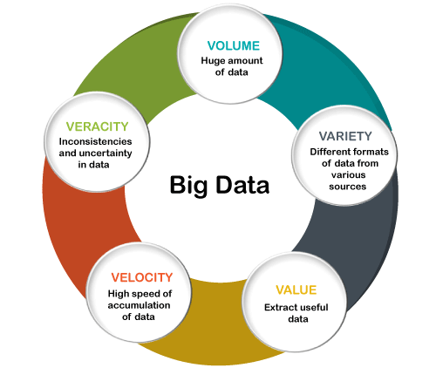

Slide 13
Volume: Refers to the enormous amount of data generated every second. With vast quantities of data coming from various sources (social media, IoT devices, transactions, etc.), Big Data focuses on managing and analyzing these massive volumes.
Velocity: This is the speed at which data is generated, collected, and processed. High velocity is critical in real-time applications like fraud detection or personalized recommendations, where immediate insights are valuable.

Slide 14
Variety: Indicates the diverse types of data sources and formats. Big Data can come from structured data (like databases), unstructured data (such as text, video, and images), or semi-structured data (like JSON files or XML).
Veracity: Represents the accuracy, quality, and trustworthiness of the data. Due to the large amount of data coming from multiple sources, there can be inconsistencies or uncertainties, which makes data quality management essential.

Slide 15
Value: The ultimate worth or usefulness of the data, representing the insights, knowledge, or actionable information that can be derived from it. Not all data is valuable, so identifying and extracting meaningful information is key.
Variability: This refers to the inconsistencies and fluctuations in data, especially with unstructured data. Data can vary in meaning or structure, adding complexity to data management and analysis.

Slide 16
but now there is “6Vs” of Big Data which are also termed as the characteristics of Big Data as follows:
Variability:
How fast or available data that extent is the structure of your data is changing?
How often does the meaning or shape of your data change?
https://www.javatpoint.com/big-data-characteristics

Slide 17
Data collection methods
Data collection methods are techniques and processes used to gather information for research purposes.
Surveys: A structured questionnaire or survey can be used to collect data from a group of people. Surveys can be conducted by mail, online, by phone, or in person.
Interviews: A researcher can gather information from a respondent in person, by phone, or through video conferencing. Interviews can be structured, semi-structured, or unstructured.
Focus groups: A small group of people discuss specific topics in a moderated setting.
Observations: A researcher can observe and record behaviors, actions, or events in their natural setting.
Experiments: A researcher can manipulate variables to observe their impact on the outcome.
Transactional tracking: A researcher can track a customer's purchases to derive data.
Textual or content analysis: A researcher can investigate changes in views on a specific topic.

Slide 18
Data collection methods can be either qualitative or quantitative. Qualitative methods help understand the driving forces behind the results. Quantitative methods include conducting experiments and observing well-defined situations or events.
Data collection methods can also be primary or secondary. Primary data is data that's gathered firsthand, while secondary data is data that has been collected previously.

Slide 19
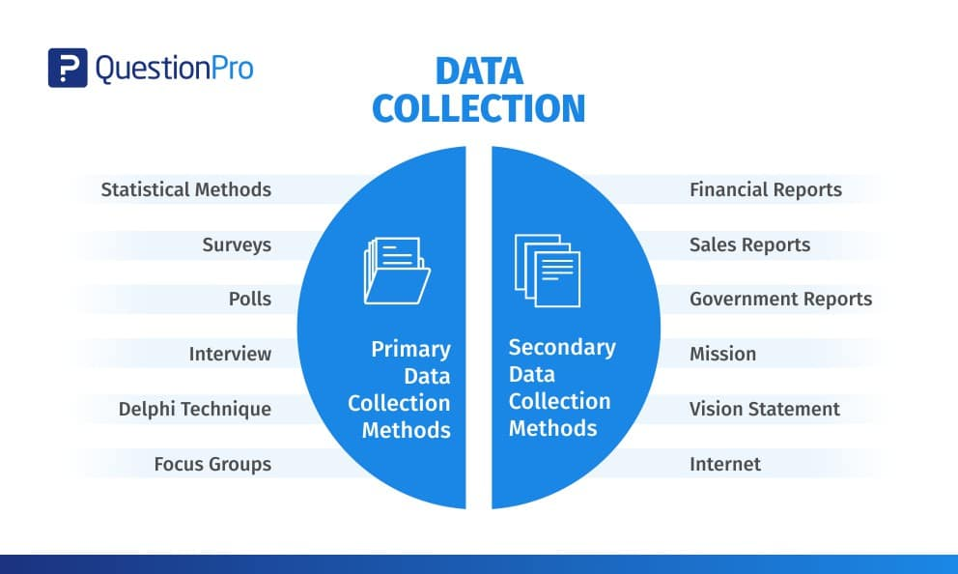
Primary vs. Secondary Data

Slide 20
Primary Data Collection Methods
Primary data is collected from first-hand experience and is not used in the past. The data gathered by primary data collection methods are highly accurate and specific to the research’s motive.
Primary data collection methods can be divided into two categories: quantitative and qualitative.

Slide 21
Secondary Data Collection Methods
Secondary data is data that has been used in the past. The researcher can obtain data from the data sources, both internal and external, to the organizational data.
Internal sources of secondary data:
Organization’s health and safety records
Mission and vision statements
Financial Statements
Magazines
Sales Report
CRM Software
Executive summaries

Slide 22
https://www.questionpro.com/blog/data-collection-methods/

Slide 23
Basics of data cleaning and transformation
Data cleaning and transformation are essential steps in preparing data for analysis and decision-making.
Data cleaning involves identifying and fixing errors, while data transformation converts data into a more suitable format.

Slide 24
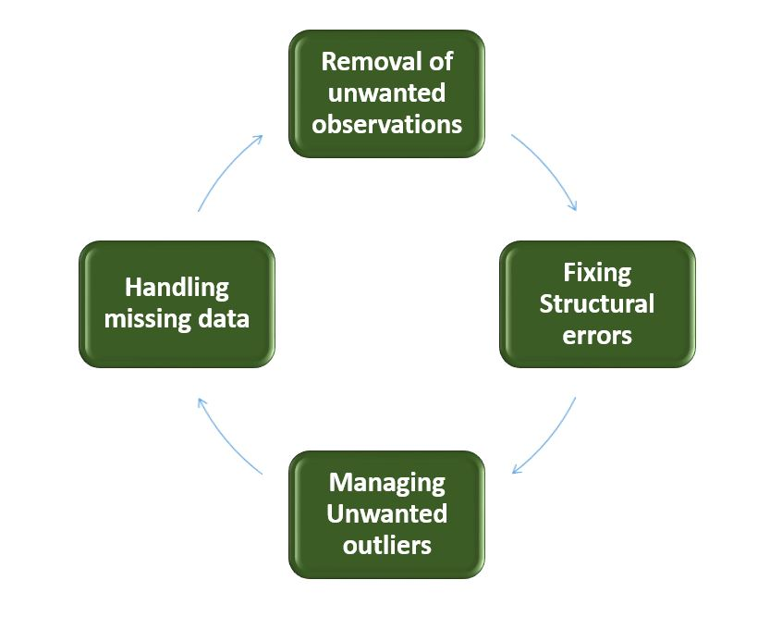

Slide 25
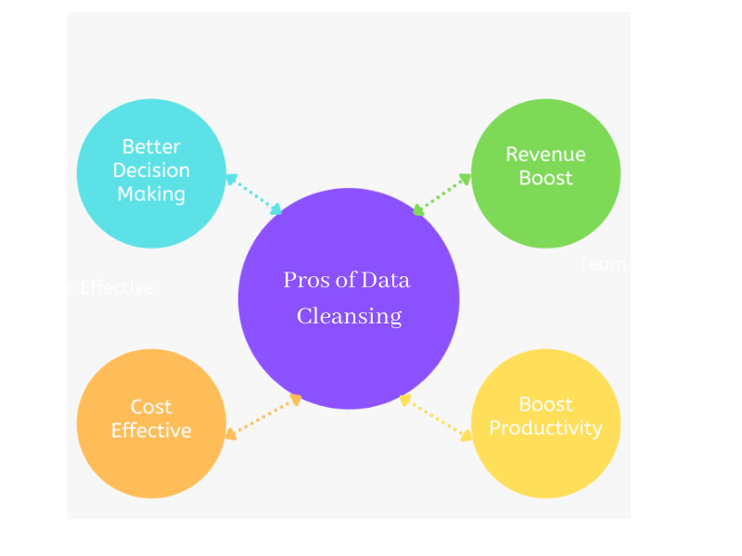

Slide 26
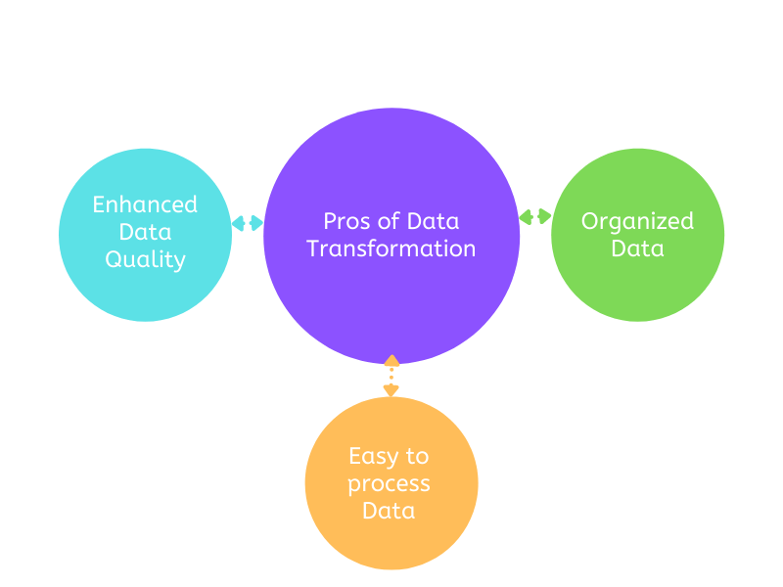

Slide 27
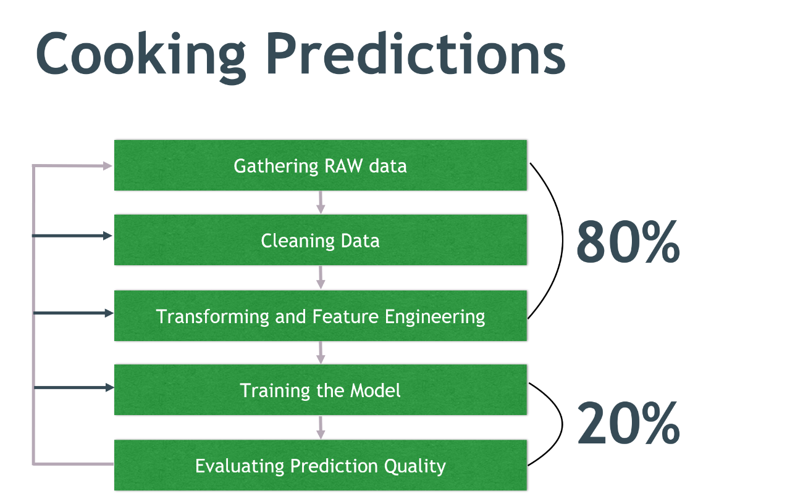

Slide 28
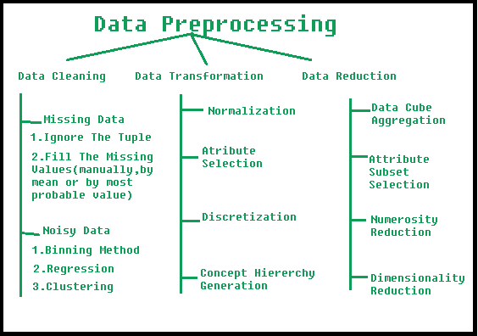

Slide 29
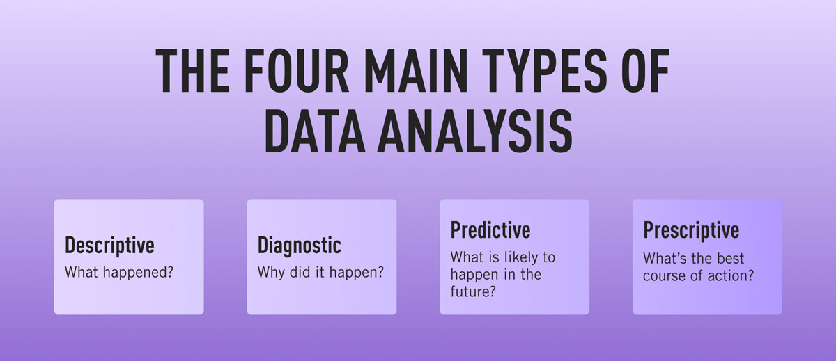
Introduction to data analytics

Slide 30
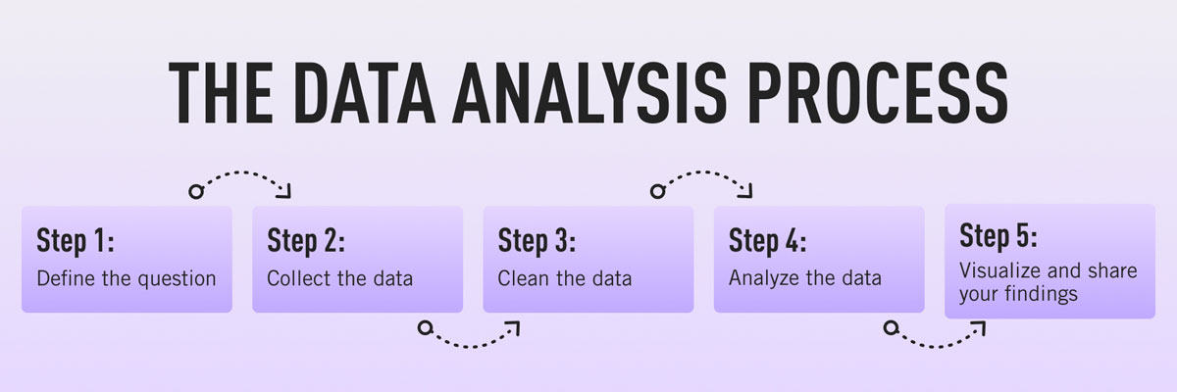

Slide 31
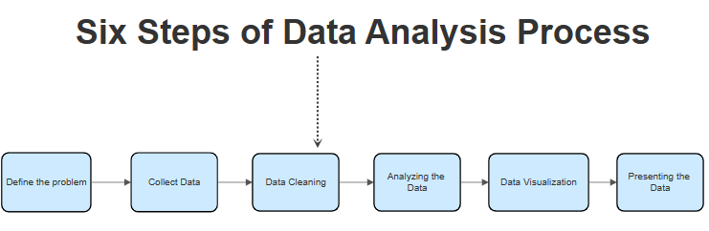

Slide 32
Most companies are collecting loads of data all the time—but, in its raw form, this data doesn’t really mean anything.
This is where data analytics comes in. Data analytics is the process of analyzing raw data in order to draw out meaningful, actionable insights, which are then used to inform and drive smart business decisions.

Slide 33
A data analyst will extract raw data, organize it, and then analyze it, transforming it from incomprehensible numbers into coherent, intelligible information. Having interpreted the data, the data analyst will then pass on their findings in the form of suggestions or recommendations about what the company’s next steps should be.

Slide 34
Types of Data Analytics
There are four major types of data analytics:
Predictive (forecasting)
Descriptive (business intelligence and data mining)
Prescriptive (optimization and simulation)
Diagnostic analytics

Slide 35
Data analytics has many real-life applications across various industries, driving decisions and efficiencies. Here are some key examples:
Healthcare: Data analytics is used to predict disease outbreaks, personalize patient treatment, and manage hospital resources. For instance, predictive analytics helps identify patients at risk of certain conditions, enabling preventive care.
Retail and E-commerce: Retailers use analytics to personalize customer experiences, forecast demand, manage inventory, and optimize pricing strategies. Amazon and Netflix, for example, recommend products and content based on user behavior analysis.
Finance and Banking: Financial institutions use data analytics to detect fraudulent transactions, assess credit risks, and enhance customer service. Fraud detection algorithms analyze transaction patterns in real-time, identifying unusual activity.
Transportation and Logistics: Companies like UPS and FedEx optimize routes using data analytics to reduce delivery times and fuel consumption. Ride-sharing services like Uber and Lyft use data to match drivers with riders efficiently.
Sports: In sports, data analytics improves team performance and player fitness. Coaches analyze players' stats, game strategies, and performance metrics. Teams in the NFL, NBA, and other leagues use analytics to gain a competitive edge.

Slide 36
Energy and Utilities: Energy companies use analytics to predict equipment failures, optimize resource usage, and reduce energy costs. Smart grids analyze consumption patterns, adjusting supply in real time to meet demand.
Education: In education, data analytics identifies students at risk of dropping out, improves personalized learning experiences, and tracks academic progress. Schools use these insights to offer tailored support, enhancing student retention and outcomes.
Marketing and Advertising: Marketers analyze consumer data to segment audiences, predict trends, and personalize ad campaigns. Data-driven insights help companies target the right audience and improve ad effectiveness.
Manufacturing: In manufacturing, data analytics helps optimize production processes, manage supply chains, and predict equipment maintenance needs. Predictive maintenance reduces downtime and repair costs.
Public Safety and Law Enforcement: Police departments use analytics to predict crime hotspots, enabling better resource allocation. For example, predictive policing helps law enforcement prevent crimes by analyzing historical crime data.

Slide 37
Data analytics offers numerous benefits that help organizations make informed decisions, optimize processes, and improve outcomes. Here are some key benefits:
Informed Decision-Making: Data analytics provides insights from historical and real-time data, enabling better decision-making based on evidence rather than assumptions.
Cost Savings: Analytics helps organizations identify inefficiencies, reduce waste, and optimize resource allocation, leading to significant cost reductions, especially in operations and supply chain management.
Enhanced Customer Experience: By understanding customer preferences and behavior, businesses can personalize experiences, improve customer satisfaction, and increase loyalty, ultimately driving sales and retention.
Operational Efficiency: Analytics identifies process bottlenecks, optimizes workflows, and predicts equipment maintenance needs, increasing productivity and reducing downtime.
Risk Management: In sectors like finance and healthcare, data analytics helps in assessing risks, detecting fraud, and making proactive decisions to minimize potential losses.

Slide 38
Predictive Capabilities: Predictive analytics enables businesses to anticipate trends and prepare for future demand, whether it’s stock levels, staffing, or market shifts, giving them a competitive edge.
Better Targeting and Marketing: Data analytics allows companies to segment customers accurately, optimize ad spending, and personalize marketing campaigns, resulting in more effective reach and conversion rates.
Improved Product Development: Analytics provides insights into customer feedback, market trends, and product performance, enabling companies to develop or improve products that better meet market needs.
Employee Productivity: Organizations use analytics to track and improve employee performance, offer targeted training, and streamline HR processes, leading to higher productivity and job satisfaction.
Enhanced Innovation: By spotting emerging trends and customer needs, data analytics fuels innovation, helping businesses adapt, evolve, and stay relevant in a changing market.

Slide 39
https://www.geeksforgeeks.org/data-analytics-and-its-type/

